Slide 1
Aim: The causes that led to WW2.
Do Now: What was in the Treaty of Versailles that made Germany hate it so much?
Agenda: 1. Do Now 2. Note taking 3. Discussion regarding the 10 Major causes. 4. Review | Vocabulary: Treaty, revenge, abdicated, self-determination, facism.
Review: How would the German people have reacted to the Treaty of Versailles?

Slide 2
10 Major Causes of WWII
Treaty of Versailles
Rise of Italian fascism
Rise of Hitler and the Nazi Party
Great Depression
Japanese expansionism
Anti-communism
Appeasement
Militarism
Nationalism
U.S. isolationism

Slide 3
Treaty of
Versailles
Rise of
Hitler
Rise of
fascism in
Italy
Nationalism
Japanese
expansionism
Major Causes
of
World War II
Militarism
Economic
depression
Appeasement
Anti-
communism

Slide 4
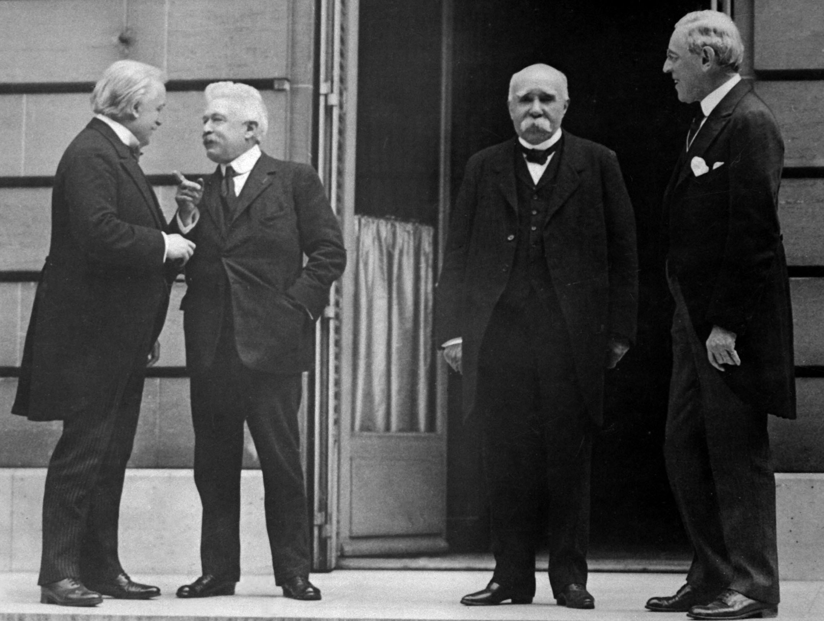
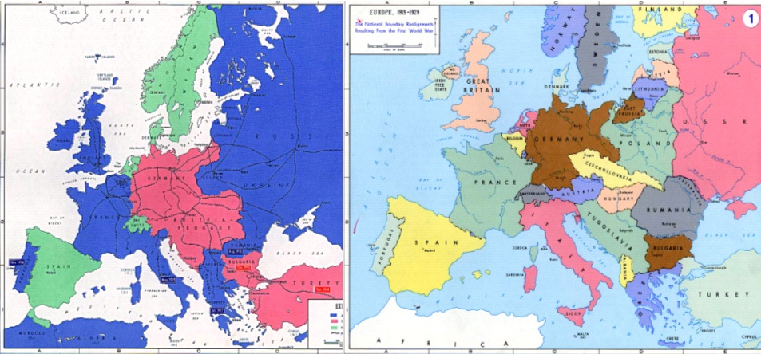
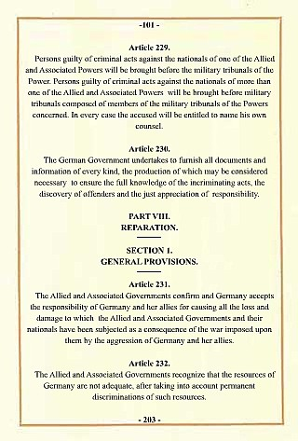
Treaty of Versailles
After Germany lost WWI, the winning nations drafted a treaty to address issues such as territorial adjustments, reparations, armament restrictions, war guilt and the League of Nations.
The treaty punished Germany and left bitter feelings.
Germany was forced to accept all the blame for the war and pay millions in reparations to Britain and France.
Italy was disappointed that it was denied territory promised by Britain and France.
British Prime Minister George
Italian Prime Minister Orlando
French Prime Minister Clemenceau
U.S. President Wilson
1914 1919
“Big Four”

Slide 5
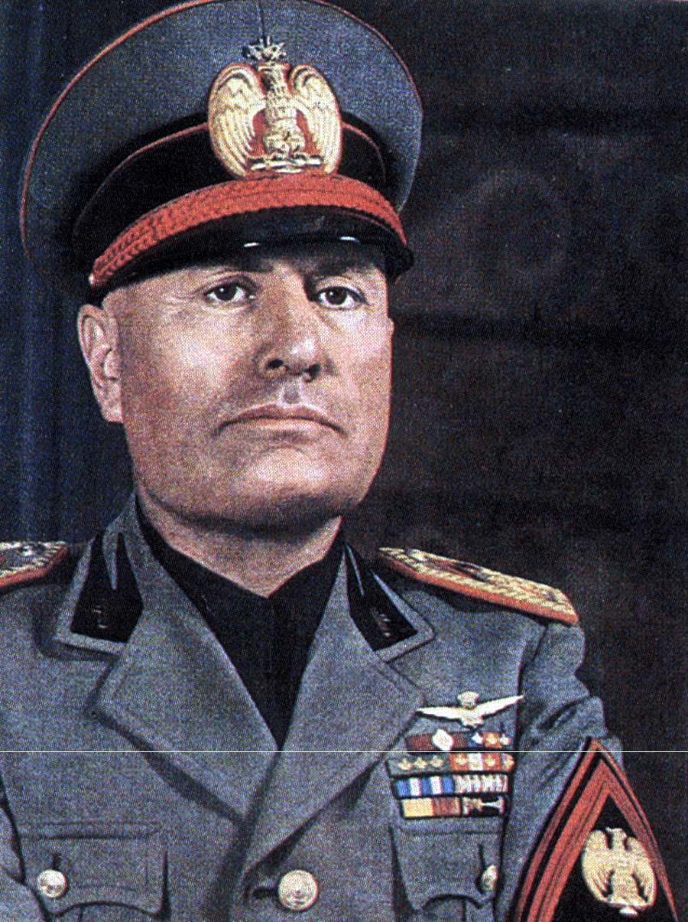

The Rise of Fascism in Italy
Fascism is a totalitarian form of government which:
Glorifies the state
Has one leader and one party
All aspects of society are controlled by the government
No opposition or protests are tolerated
Propaganda and censorship are widely practiced
Benito Mussolini came to power in 1922 and helped found the political ideology of fascism. He sided with the Axis powers in 1940.

Slide 6
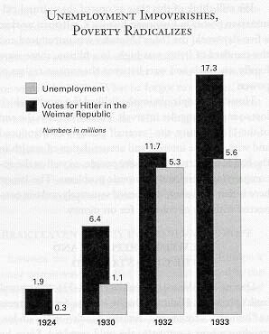
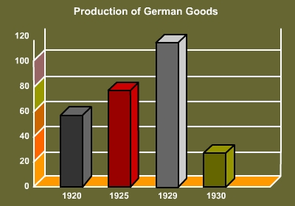
In Germany, depression, unemployment and hard times led to a dramatic increase in votes for Hitler and the Nazi Party.
Election date | Votes in millions | Share
May 20, 1928 | 0.81 | 2.6%
September 14, 1930 | 6.41 | 18.3%
July 31, 1932 | 13.75 | 37.3%
November 6, 1932 | 11.74 | 33.1%
March 5, 1933 | 17.28 | 43.9%
Voting for Hitler’s party increased as unemployment rates rose

Slide 7
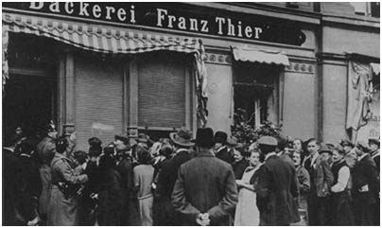
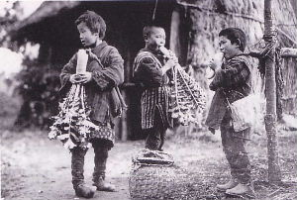

Worldwide Economic Depression
After WWI many European economies were unstable.
The boom in the U.S. throughout the 1920s helped sustain worldwide trade.
The 1929 stock market crash in the U.S. and the resulting Great Depression spread throughout the world. U.S. restrictive tariff policies worsened the depression.
As economies plummeted and unemployment rose, many people turned to powerful leaders and governments who promised success through military buildup and the conquest of territory.
German breadlines
Japanese children eating radish roots during famine

Slide 8
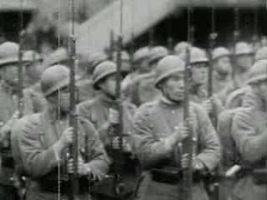
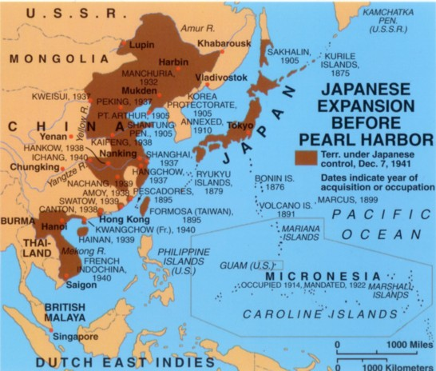
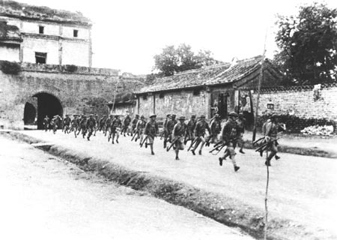
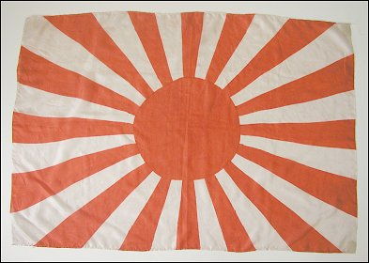
Japanese Expansionism
In 1931 Japan invaded Manchuria for raw materials.
The same year, Japan began to attack China, with full-scale war breaking out in 1937 in the Sino-Japanese War.
In 1938, war broke out between Japan and the Soviet Union in what were known as the Soviet-Japanese Border Wars.

Slide 9
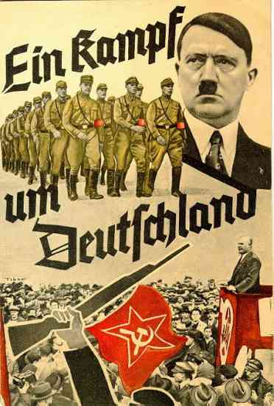
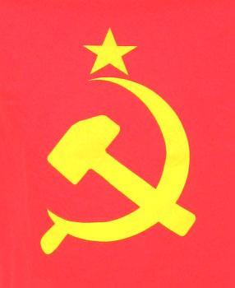
Anti-Communism
Under communism, all means of production are controlled by the government, as are property, the media, and all other aspects of society.
The 1930s saw the rise of many totalitarian regimes; but most people chose fascism over communism.
Hitler exploited people’s fear of a communist takeover in Germany to rise to power in 1933.
A Battle for Germany: Nazi anti-communist book from 1933

Slide 10
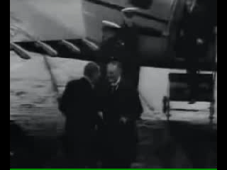
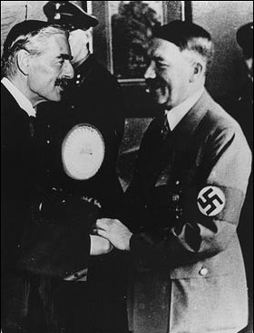
Appeasement
Appeasement is the act of giving in to an enemy’s demands in hopes of avoiding further conflict.
In 1938, Hitler demanded that Czechoslovakia cede the Sudetenland to Germany. He claimed that the German population living there was being mistreated.
The British and French prime ministers agreed to Hitler’s demands without consulting Czechoslovakian leaders, in the hopes that this would avoid a war in Europe.

Slide 11
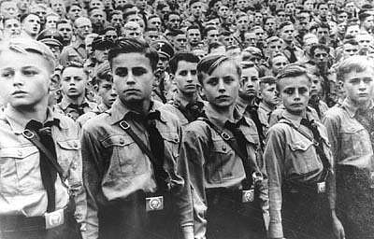
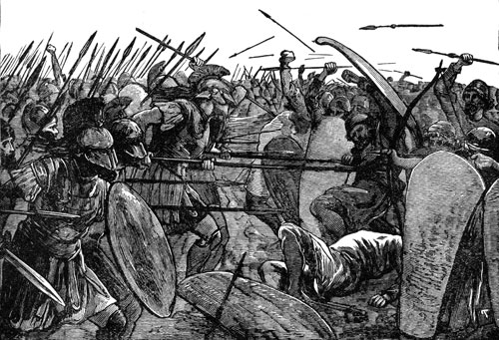
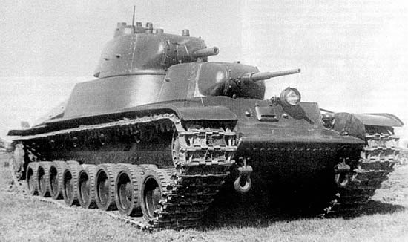
Militarism
The glorification of war, in which a nation strengthens its military and stockpiles weapons in preparation for war.
An important aspect of militarism is that the glorification of war is incorporated into all levels of society, including education of the nation’s youth.
Militaristic societies have existed throughout human history.
Hitler Youth group
Ancient Sparta is an example of a militaristic society

Slide 12
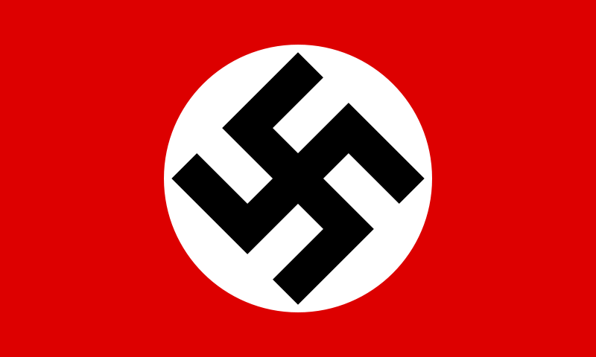

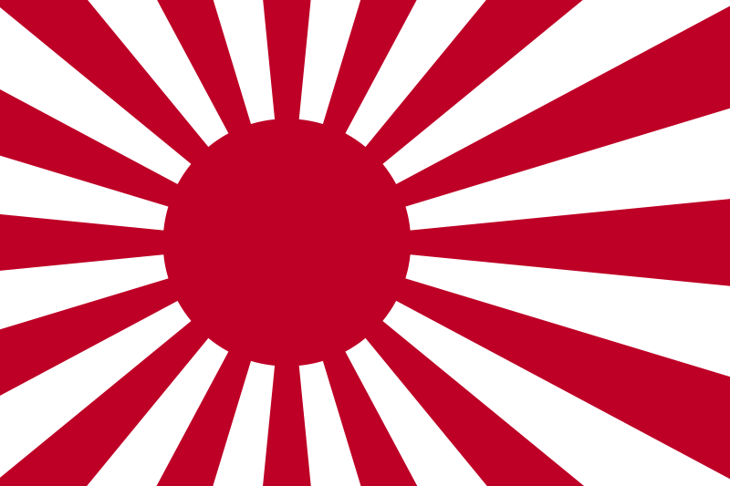
Nationalism
Nationalism is the belief in the superiority of one’s own nation over all others.
In the extreme, it can lead to major conflicts between nations.
Hitler, Mussolini, and Japan’s Tojo each touted their nation’s ability to dominate all others in the years leading up to WWII.
Nazi flag, Italian fascist logo, Japanese flag

Slide 13
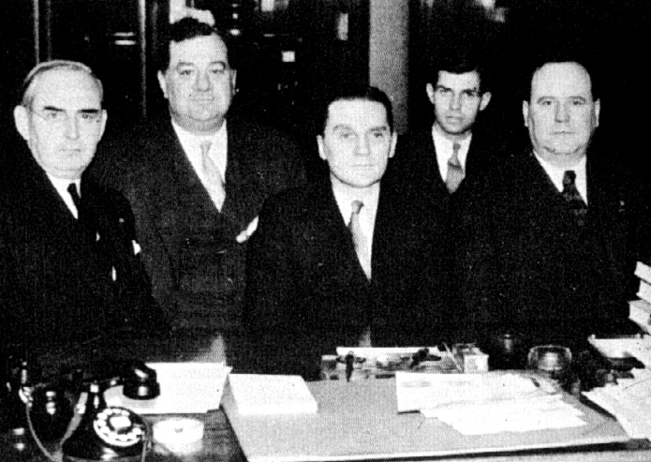
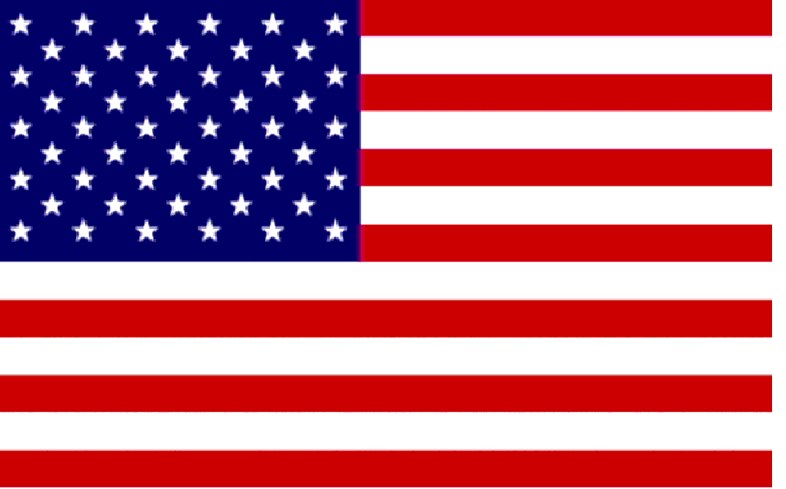
American Isolationism
The failure of peace efforts such as the Kellogg Briand Treaty during the 1920s disillusioned many Americans about international involvement.
The U.S. was in a major depression throughout the 1930s and was mostly concerned with its own problems.
Conflict in Europe seemed distant, and the U.S. tried to remain neutral. This policy weakened the European democracies.
The Nye Committee held congressional hearings in the mid-1930s, concluding that the U.S. was tricked into entering WWI by arms manufacturers and Allied propaganda.

Slide 14
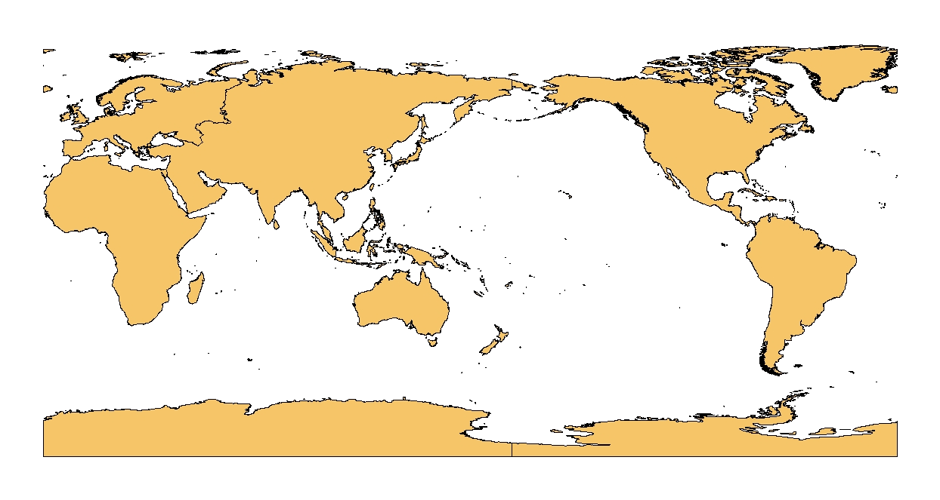
Theaters of War: Where WWII Was Fought
Europe
Atlantic Ocean
Asia
North Africa
Pacific

Slide 15
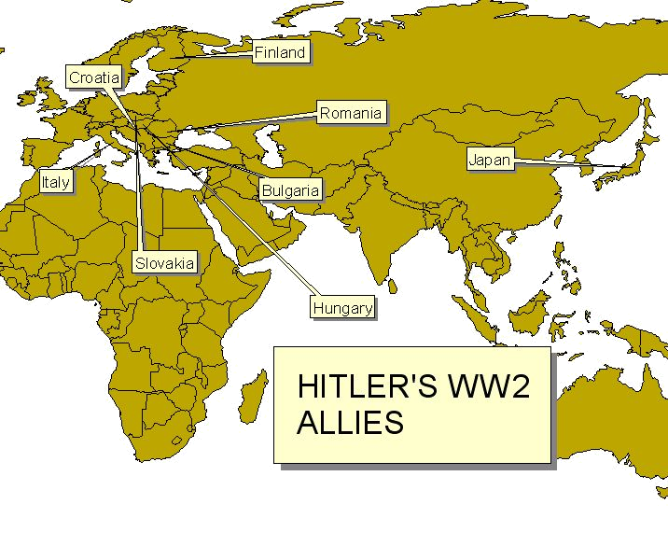
HITLER’S WWII PARTNERS

Slide 16
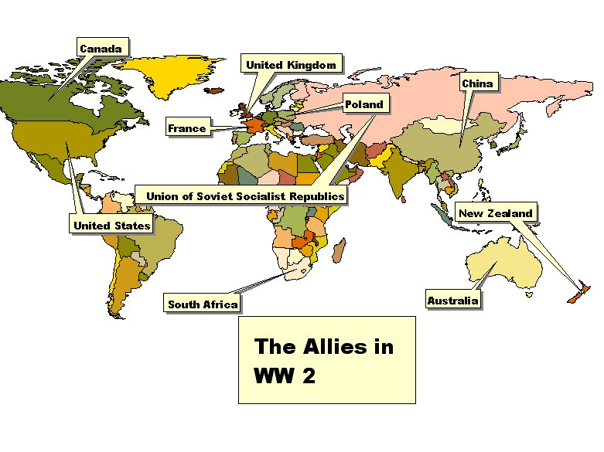
India
Brazil
THE ALLIED POWERS IN WWII
Notes:
These are the nations that had a substantial number of soldiers involved in the fighting.

